Slide 1
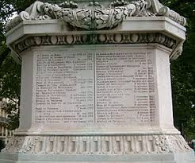
Dr.Vishwajeet Singh Parmar Ancient Indian History Culture And Archaeology Vikram University,Ujjain (M.P.)
MA IV SEMESTER
HISTORY OF INSCRIPTIONS

Slide 2
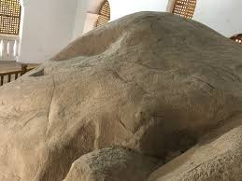
Languages Of Ancient And Early Medieval Inscriptions
The earliest Brahmi inscriptions, including those of Ashoka, are in dialects of Prakrit (also known as Middle Indo-Aryan). Between the 1st and 4th centuries CE, many inscriptions were written in a mixture of Sanskrit and Prakrit. The first pure sanskrit inscriptions appeared in the 1st century BCE. The first long sanskrit inscription is the Junagadh rock inscription of the western Kshatrapa king Rudradaman.

Slide 3
By about the end of the 3rd century CE, Sanskrit had gradually replaced Prakrit as the language of inscriptions in Northern India. In the Deccan and South India, Sanskrit inscriptions appeared along with Prakrit ones in the late 3rd /early 4th century CE, for instance at Nagarjunakonda in Andhra Pradesh. The Sanskrit element gradually increased. In the transitional phase of the 4th and 5th centuries, there were bilingual Sanskrit-Prakrit inscriptions as well as those in a mixture of the two languages. Thereafter, Prakrit fell into disuse.

Slide 4
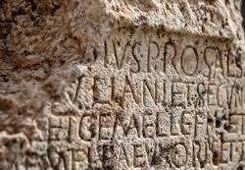
Classification of Inscriptions
Inscriptions can be classified in several different ways, for instance, according to the surface they are engraved on language, age and geographical region.
They can also be classified into official and private records, depending on whose behalf they were inscribed. Ashoka’s edicts and Royal land grants are examples of official records. Inscriptions recording grants made by private individuals or guilds to temples, or to Buddhist or Jain establishments are examples of private records.

Slide 5
Inscriptions can also be classified according to their content and purpose into types such as donative, dedicative and commemorative inscriptions.
Lumbini pillar inscription of Ashoka is a Royal commemorative inscription, recording a specific event- the visit of the king to the Buddha’s birth-place. In many parts of India, there is evidence of an Ancient practice of erecting memorials to dead people. Thousands of memorial stones are found all over the country, not always connected with burials.

Slide 6
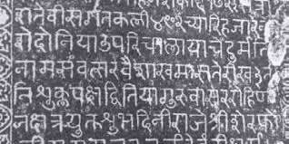
Some only have sculpted scenes ( realistic or symbolic), others also have inscriptions. The most common memorial stones were erected in memory of dead heroes or women who committed sati. But there are other kinds as well. Stones were set up in honor of Jain men and women who gave up their lives in the exemplary Jain fashion of death by starvation. On the Konkan coast, many stones were erected in memory of sailors who lost their lives in sea battles. Some memorial stones were worshipped.

Slide 7
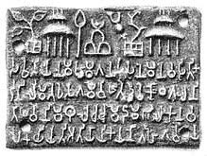
Donative inscriptions in favour of religious establishments were inscribed on shrine walls ,railings and gateways. The excavation and donation of caves to ascetics were recorded in inscriptions in the caves. Donative inscriptions include records of the installation of religious images, often inscribed on the image themselves. Others record investment of money made by people, out of the interest of which lamps, flowers, incense etc.,were to be provided for the worship of the Deity.

Slide 8
Royal land grants are an important category of donative records. There are thousands of such inscriptions, some on stone, but mostly inscribed on one or more copper plates. Most of them record grants made by kings to Brahmanas and religious establishments. The earliest stone inscriptions recording land grants with tax exemptions are Satvahana and Kshatrapa epigraphs found at Nashik.
The mid 4th century Pallava and Shalankayana grants are the earliest surviving copper plate grants. One of the oldest copper-plate grants from North India is the late 4th century CE Kalachala grant of king Ishvararata.

Slide 9
Royal inscriptions include prashastis (panegyric). Most royal inscriptions (and some private ones too) usually begin with a prashasti, but some inscriptions are entirely devoted to eulogizing their subject .well known examples are the Hathigumpha inscription of Kharavela , the 1st century BCE/1st century CE king of Kalinga in Orissa and the Allahabad prashasti of the 4th century Gupta emperor Samudragupta .Certain inscriptions record the building of water works , wells and charitable feeding houses by private individuals .

Slide 10
A series of unique records of royal initiatives of this kind are inscribed on a granite rock at Junagadh (Girnar) in Gujrat. Apart from a set of Ashokan edicts,this rock bears two other important inscriptions . A 150 CE inscription of the Shaka ruler Rudradaman records the beginning of the construction of a water reservoir known as Sudarshan lake in the 4th century BCE during the time of the Maurya emperor Chandragupta , its completion during the reign of Ashoka , and its repair in Skandgupta, describes how the lake burst its banks due to excessive rains and was repaired after two years work .

Slide 11
Inscriptions as a source of History
The text of inscriptions maybe brief , but a large number of short inscriptions can often provide important historical information . Inscriptions are a valuable source of information on political history. The geographical spread of a king’s inscriptions is often taken as indicating the area under his political control .
Their prashastis give details about the history of dynasties and the reigns of kings . Of course , there are problems . Royal inscriptions naturally tend to exaggerate the achievements of the ruling king.

Slide 12
Sometimes , confusion is created when a genealogy mentions kings with the same name, or when different inscriptions contradict each other on particular details .
Inscriptions , especially those of the early medieval period , have been used as a major source of information on political structures and administrative and revenue systems .
Inscriptions reflect the history of languages and litrature and a few references to the performing arts . For instance , the 7th century Kudumiyamalai inscription gives the musical notes used in seven classical ragas .

